Slide 1




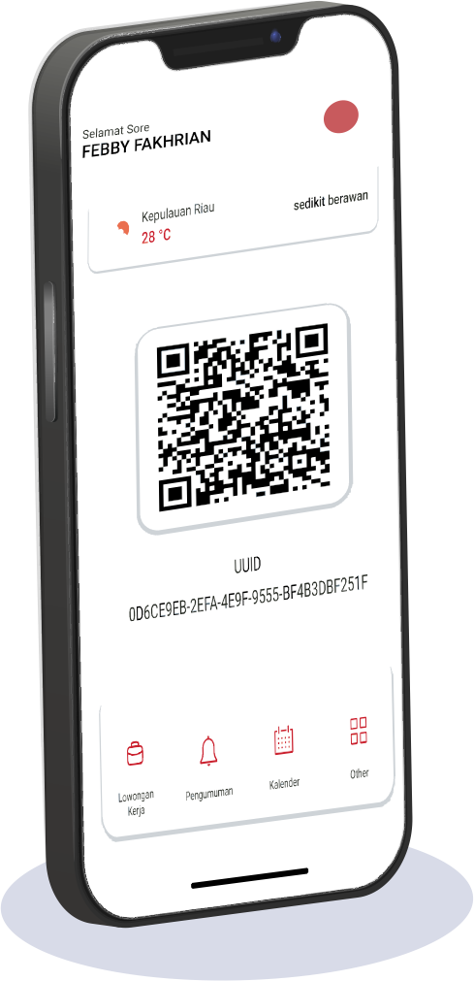

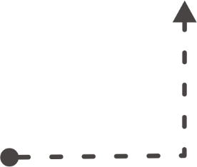
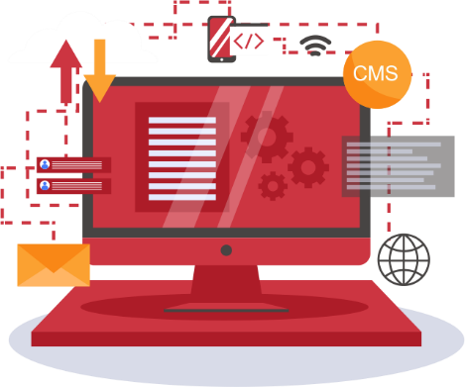




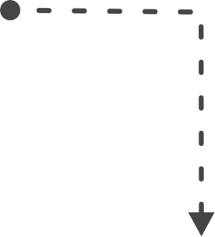







SATNUSA DIGITAL TRANSFORMATION PLATFORM
MYSATNUSA
SUPER APP

Slide 2



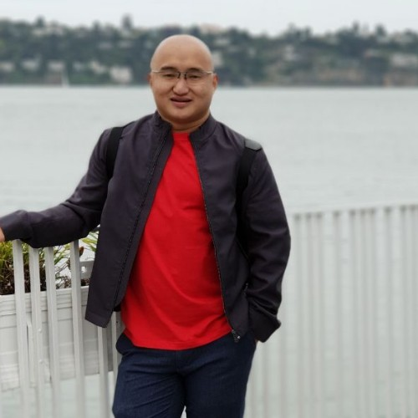




ALI
8 Year experience as a Software Consultant in a multinational company in Singapore.
SADIKIN MA
Digital Transformation Expert
Three times awarded for the transformation of business to digital 4.0 at various national levels throughout Indonesia.
1st Place Winner of Startup Worldcup
Top 10 of Bubu Awards
1st Place Winner of NEXTDEV
TELKOMSEL
4 Years experienced in Digital 4.0 Transformation Both National and International
I have participated in several international conferences organized by Google in Silicon Valley - USA, as well as the UNCTAD & ALIBABA e-founder fellowship program in Hangzhou, China.
Notes:
Buat animasi yang lebih keren lagi.
- Pertama muncul informasi 8 years experience…
- Saat click, Lanjut three times awarded…
- Click lagi, Lanjut I have participated…

Slide 3
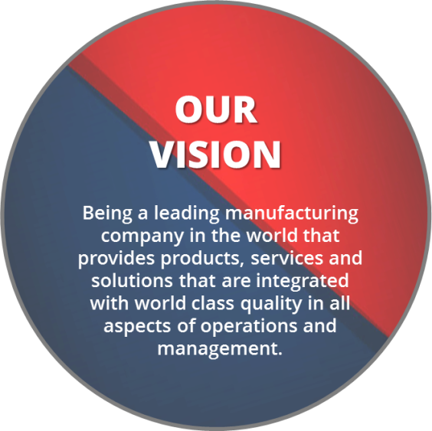
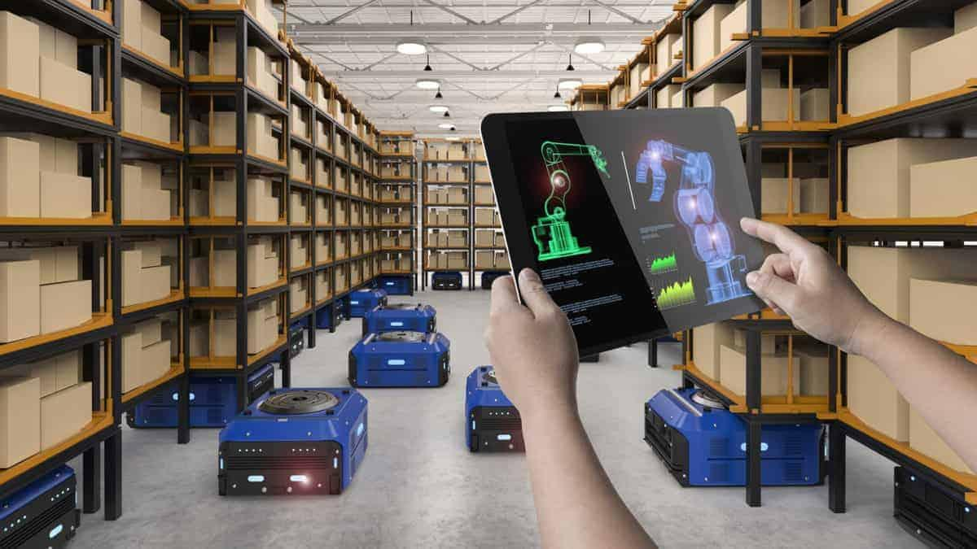
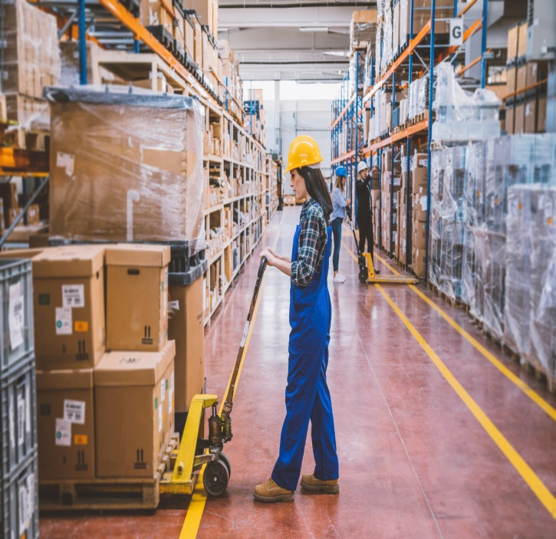
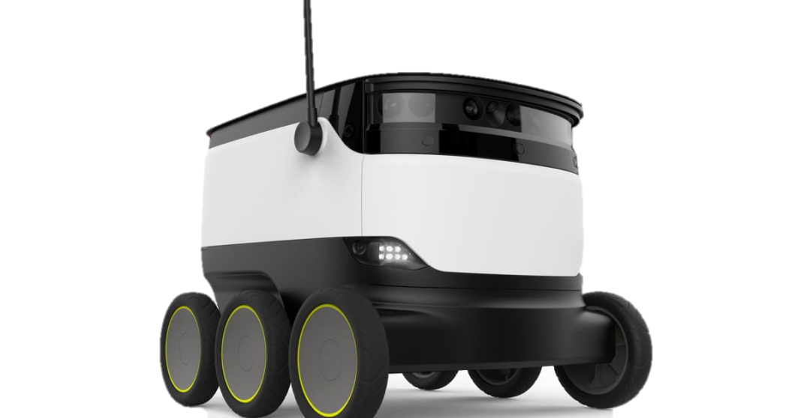
4.0
2.0
3.0
1.0
manufacturing
Is changing…
Notes:
Buat animasi utk slide ini

